Slide 1
Non-Linear Lists
Materials are adapted from “Data Structures: A Pseudocode Approach with C,” 2nd ed., by Richard F. Gilberg & Behrouz A. Forouzan

Slide 2
Non-linear lists
Non-linear list
A list in which each element can have more than one successor
Trees
In a tree each element, except the root, can have only one predecessor
Two-way tree (binary tree)
Each element can have up to two successors
Multiway tree
There is no limitation on the number of successors
Graphs
In a graphs each element can have one or more predecessors

Slide 3
Introduction to Trees

Slide 4
Basic Tree Concepts
A tree consists of finite set of elements, called nodes, and a finite set of directed lines called branches, that connect the nodes
The number of branches associated with a node is the degree of the node
When the branch is directed toward the node, it is indegree branch.
When the branch is directed away from the node, it is an outdegree branch.
The sum of the indegree and outdegree branches is the degree of the node

Slide 5
Basic Tree Concepts
If the tree is not empty, the first node is called the root
The indegree of the root is, by definition, zero
With the exception of the root, all of the nodes in a tree must have an indegree of exactly one; that is, they may have only one predecessor
All nodes in the tree can have zero, one, or more branches leaving them; that is, they may have outdegree of zero, one, or more

Slide 6
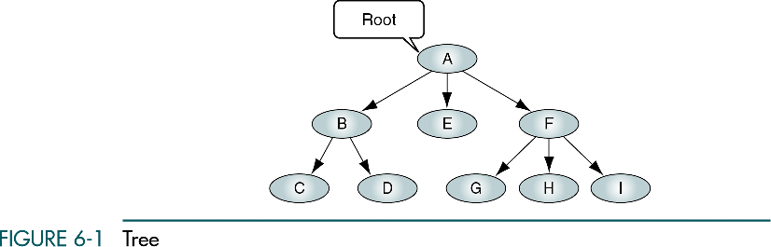

Slide 7
Terminology
A leaf is any node with an outdegree of zero, that is, a node with no successors
A node that is not a root or a leaf is known as an internal node
A node is a parent if it has successor nodes; that is, if it has outdegree greater than zero
A node with a predecessor is called a child
Two or more nodes with the same parents are called siblings
An ancestor is any node in the path from the root to the node.
A descendant is any node in the path below the parent node; that is, all nodes in the paths from a given node to a leaf are descendants of that node

Slide 8
Terminology
A path is a sequence of nodes in which each node is adjacent to the next node
Every node in the tree can be reached by following a unique path starting from the root
The level of a node is its distance from the root. The root is at level 0, its children are at level 1, etc. …
The height of the tree is the level of the leaf in the longest path from the root plus 1 (= depth)
A subtree is any connected structure below the root.
The first node in the subtree is known as the root of the subtree and is used to name the subtree

Slide 9
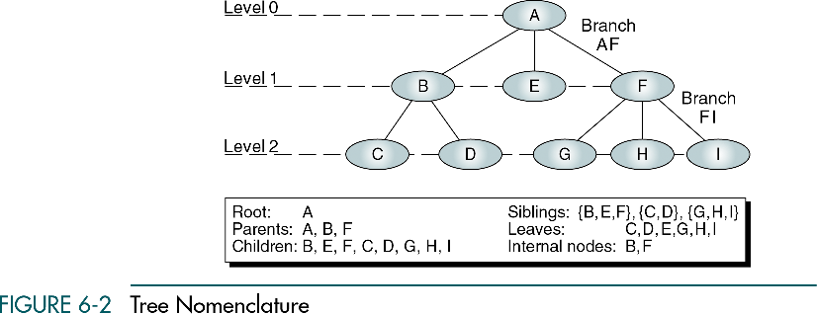

Slide 10
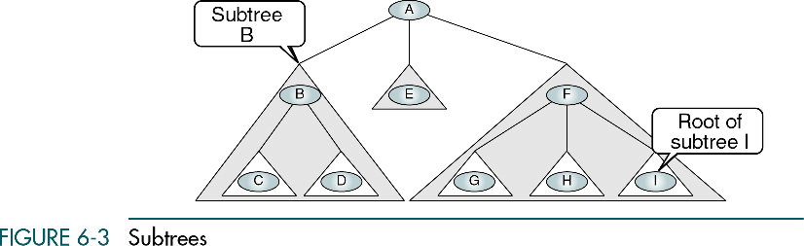

Slide 11
Recursive definition of a tree
A tree is a set of nodes that either:
is empty or
has a designated node, called the root, from which hierarchically descend zero or more subtrees, which are also trees.

Slide 12
Tree Representation
General Tree – organization chart format
Indented list – bill-of-materials system in which a parts list represents the assembly structure of an item
Parenthetical Listing –each open parenthesis indicates the start of a new level; each closing parenthesis completes the current level and moves up one level in the tree

Slide 13
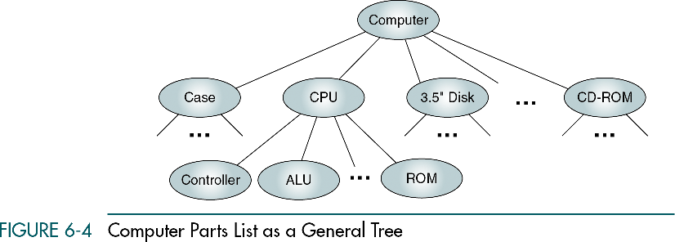
General Tree

Slide 14
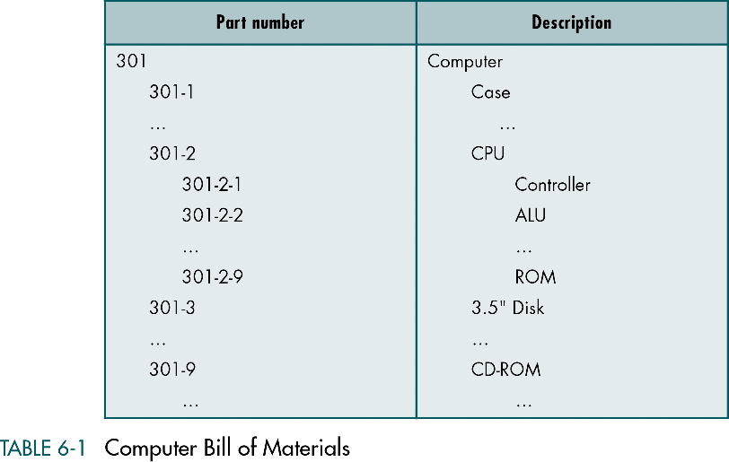
Indented list

Slide 15
Parenthetical Listing
A (B (C D) E F (G H I) )

Slide 16
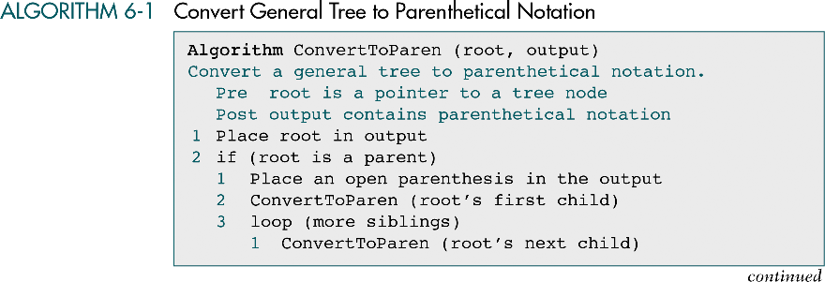
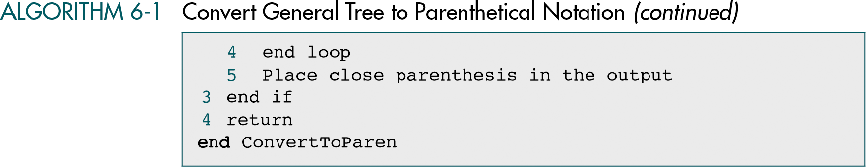

Slide 17
Binary Trees
A binary tree is a tree in which no node can have more than two subtrees; the maximum outdegree for a node is two
In other words, a node can have zero, one, or two subtrees.
These subtrees are designated as the left subtree and the right subtree

Slide 18
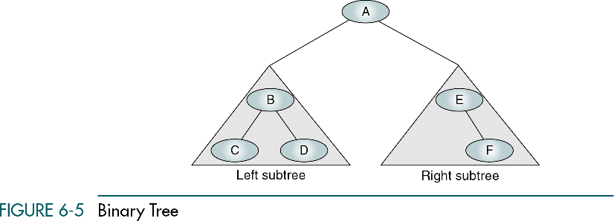
Binary Trees

Slide 19
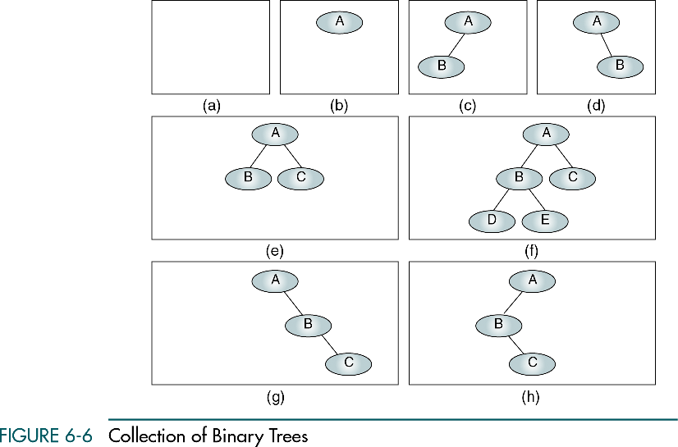
A null tree is a tree with no nodes

Slide 20
Properties of Binary Trees
The height of binary trees can be mathematically predicted
Given that we need to store N nodes in a binary tree, the maximum height is
The minimum height of a binary tree is determined as follows:

Slide 21
Properties of Binary Trees
Given a height of the binary tree, H, the minimum number of nodes in the tree is given as follows:
Given a height of the binary tree, H, the maximum number of nodes in the tree is given as follows:

Slide 22
Balance
The shorter the tree, the easier it is to locate any desired node in the tree
The balance factor of a binary tree is the difference in height between its left and right subtrees:
In a balanced binary tree (definition of Adelson-Velsky and Landis) the height of its subtrees differs by no more than one (its balance factor is -1, 0, or 1), and its subtrees are also balanced

Slide 23
Balance of the tree
B=0
B=0
B=1
B=-1
B=0
B=1
B=-2
B=2

Slide 24
Complete and nearly complete binary trees
A complete tree has the maximum number of entries for its height (N_{max})
The maximum number is reached when the last level is full.
A tree is considered nearly complete if it has the minimum height for its nodes and all nodes in the last level are found on the left (H_{min})

Slide 25
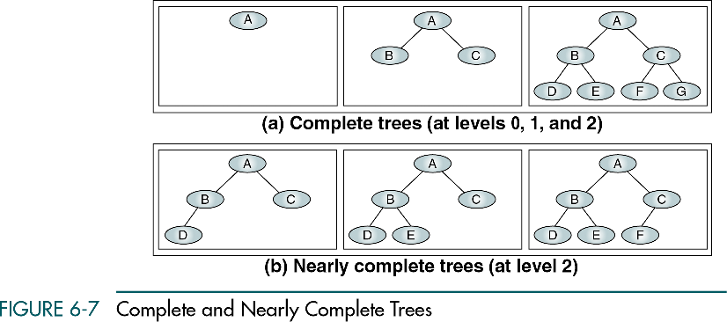

Slide 26
Binary Tree Traversals
A binary tree traversal requires that each node of the tree be processed once and only once in a predetermined sequence.
In the depth-first traversal
processing proceeds along a path from the root through one child to the most distant descendant of that first child before processing a second child
In the breadth-first traversal
Processing proceeds horizontally from the root to all of its children, then to its children’s children, and so forth

Slide 27
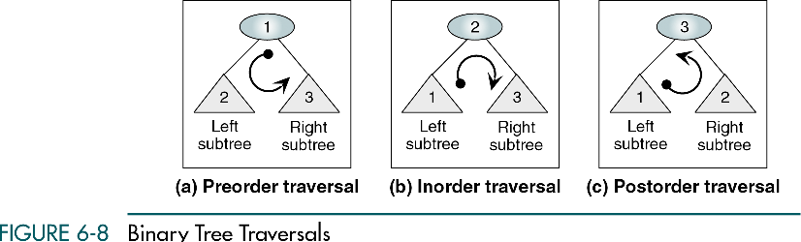
Depth-first traversals
Node (N) for root, left (L), and right (R)
Preorder traversal (NLR)
Inorder traversal (LNR)
Postorder traversal (LRN)

Slide 28
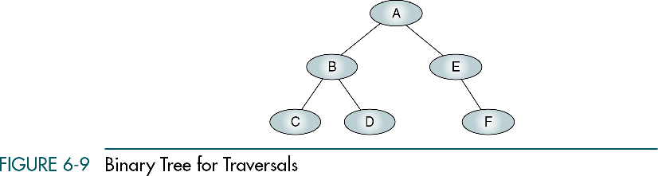

Slide 29
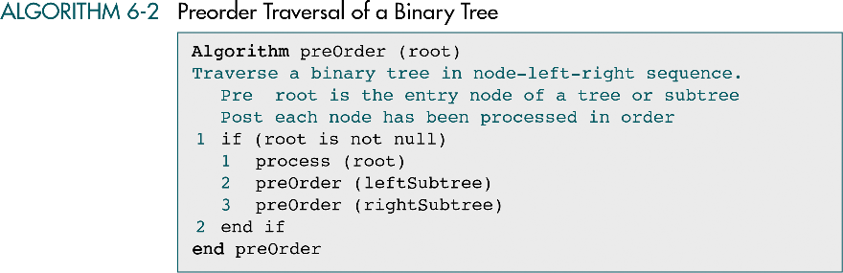

Slide 30
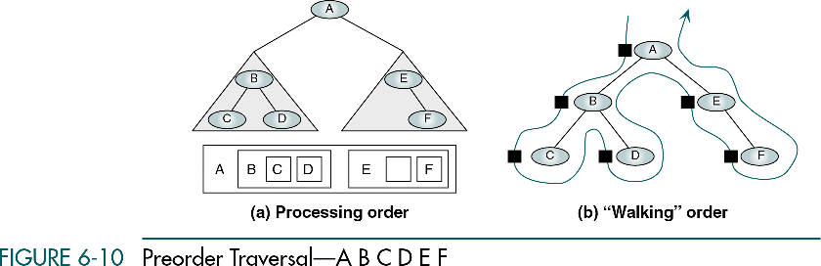

Slide 31
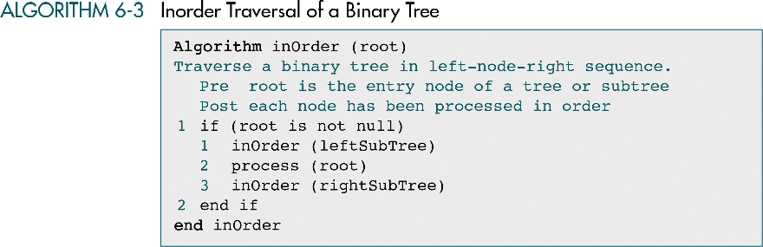

Slide 32
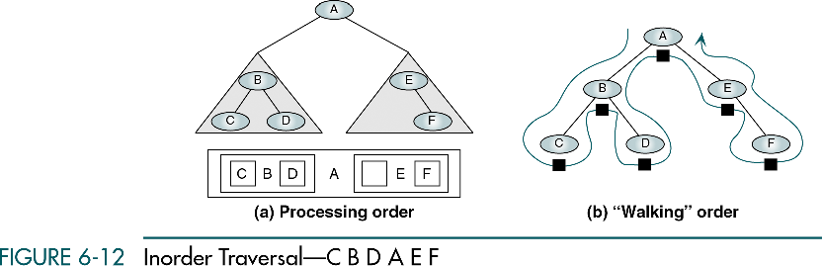

Slide 33
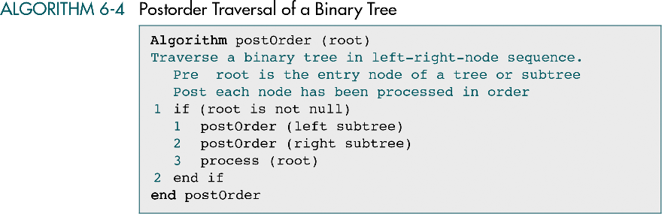

Slide 34
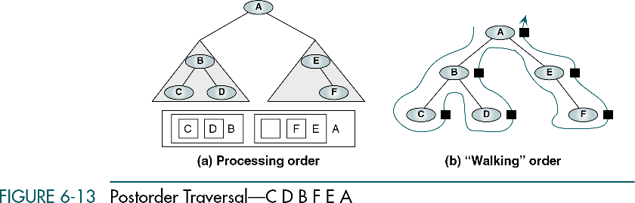

Slide 35
Breadth-first traversals
We process all of the children of a node before proceeding with the next level
To traverse a tree in depth-first order, we used a stack (recursion uses a stack)
To traverse a tree in breadth-first traversal, we use a queue

Slide 36
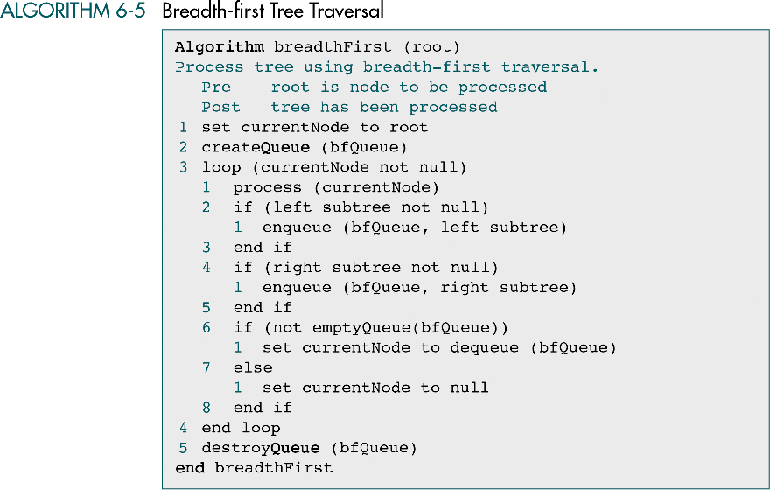

Slide 37
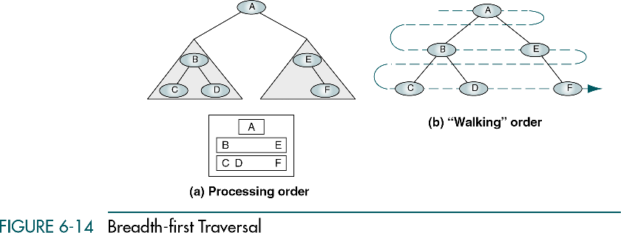

Slide 38
Expression Trees
An application of binary tree
Expression tree is a sequence of tokens
A token may be either an operand or an operator
Binary arithmetic operators (+, -, *, /)
operand-operator-operand
Each leaf is an operand
The root and internal nodes are operators
Subtrees are subexpressions

Slide 39
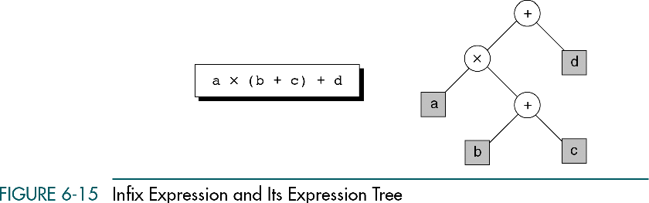

Slide 40
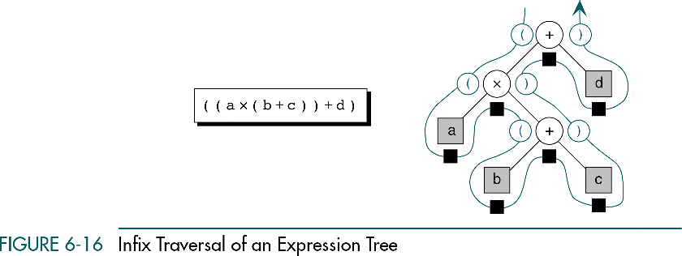

Slide 41
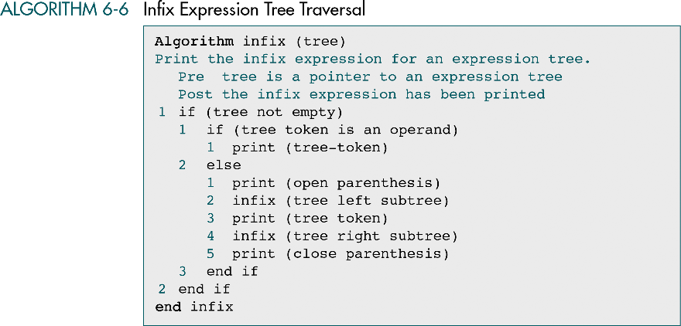

Slide 42
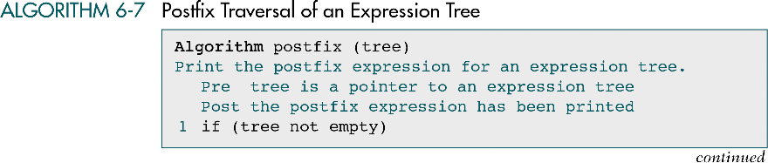

It does not require parentheses!

Slide 43
General Trees
A general tree is a tree which each node can have an unlimited outdegree

Slide 44
Insertions into general trees
To insert a node into a general tree, the user must supply the parent of the node
Given the parent, three rules may be used
First-in first-out (FIFO) insertion
Last-in first-out (LIFO) insertion
Key-sequenced insertion

Slide 45
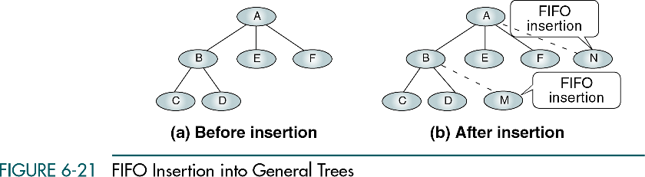
FIFO insertion
FIFO insertion places the nodes at the end of the sibling list (as a queue)

Slide 46
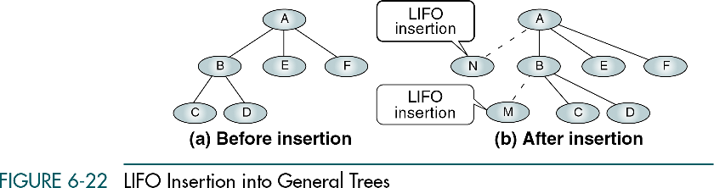
LIFO insertion
LIFO insertion places the nodes at the beginning of the sibling list (as a stack)

Slide 47
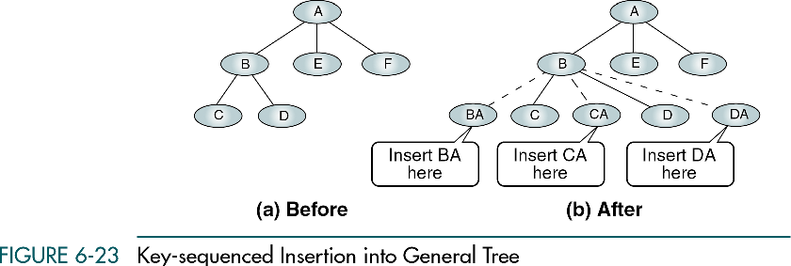
Key-sequenced insertion
Key-sequenced insertion places the new node in key sequence among the sibling nodes (as a general list)

Slide 48
General tree deletions
Standard deletion rule
A node may be deleted only if it is a leaf

Slide 49
Changing general trees to a binary tree
To represent binary trees in programs is easier than to represent general trees
Two relationships in a general tree
parent to child, sibling to sibling
To change to a binary tree
Branch from parent to its first child → left pointer (binary tree)
Connecting siblings → right pointer (binary tree)
Removing all unneeded branches from parent to its children

Slide 50
